Slide 1
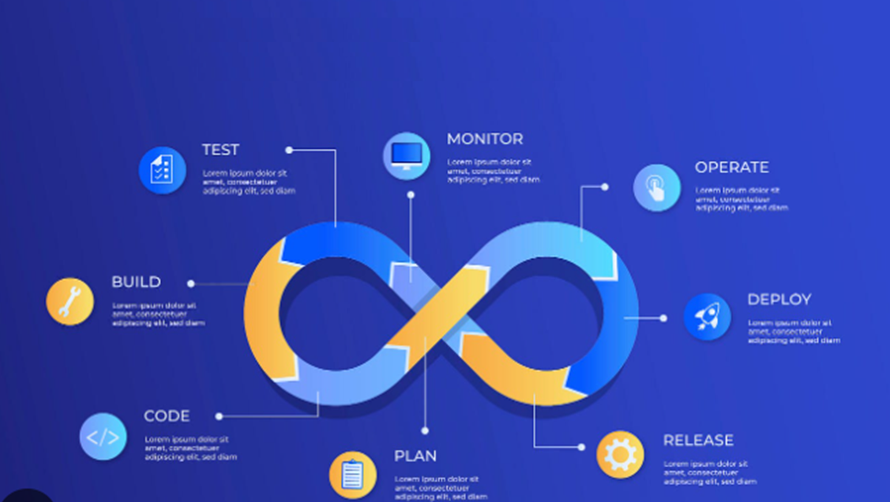
DevOps:
Bridging the Gap Between Development and Operations
Fosters collaboration between Development and Operations teams.
Traditional siloed approach between Dev and Ops, leading to slow delivery and bottlenecks.
DevOps bridges this gap, enabling faster and more reliable software delivery.
Notes:
Briefly introduce DevOps as a culture and set of practices that fosters collaboration between Development and Operations teams.
Highlight the traditional siloed approach between Dev and Ops, leading to slow delivery and bottlenecks.
Emphasize how DevOps bridges this gap, enabling faster and more reliable software delivery.

Slide 2
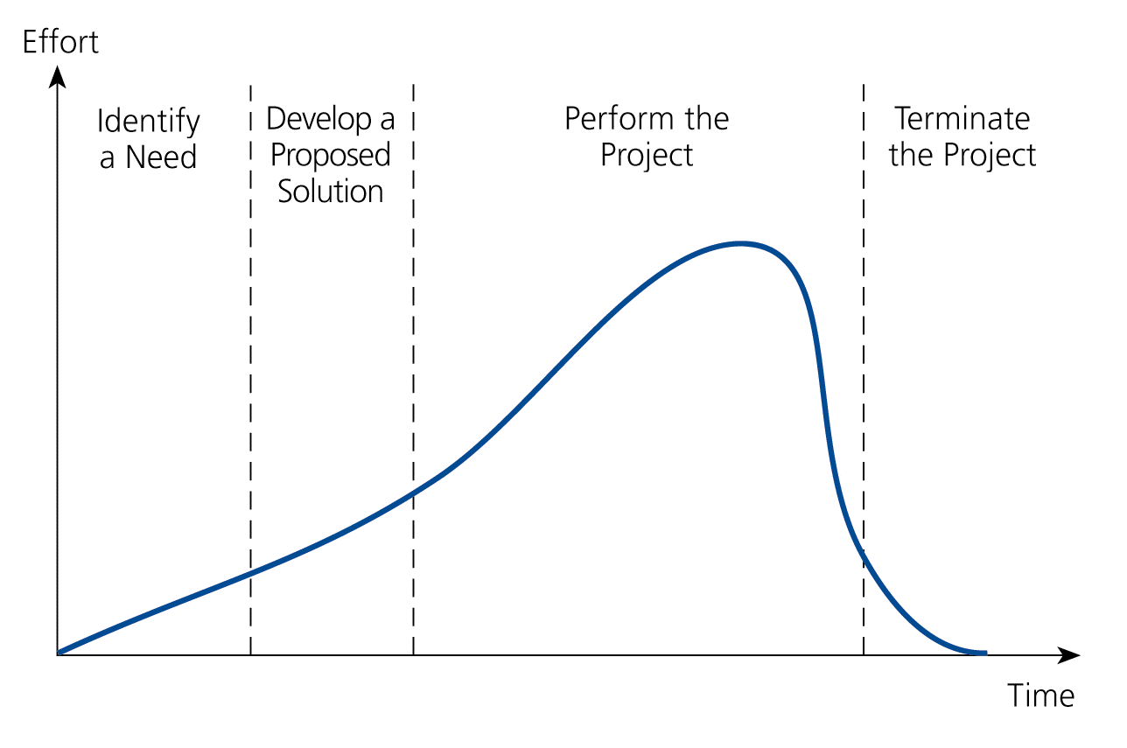
Typical Project Life-Cycle
(4 Phases)
Stages (Phases) I II III IV

Slide 3
Software development lifecycle (Unified Process)
Inception
Elaboration
Construction
Transition

Slide 4
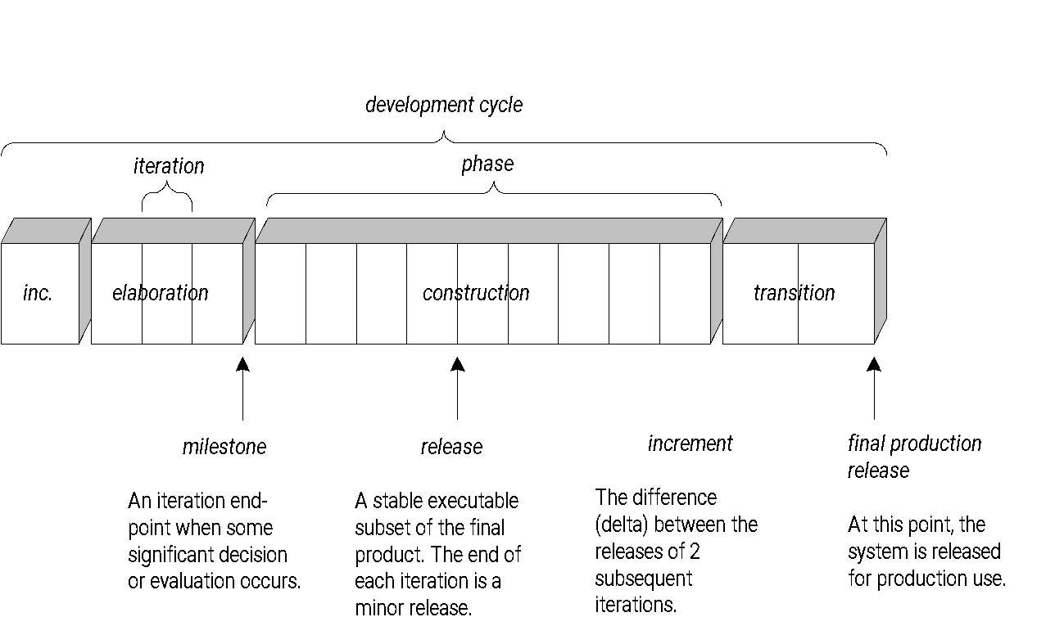
UNIFIED PROCESS phases
October 10, 2020
SEWI ZG512 Object Oriented Analysis and Design
4

Slide 5
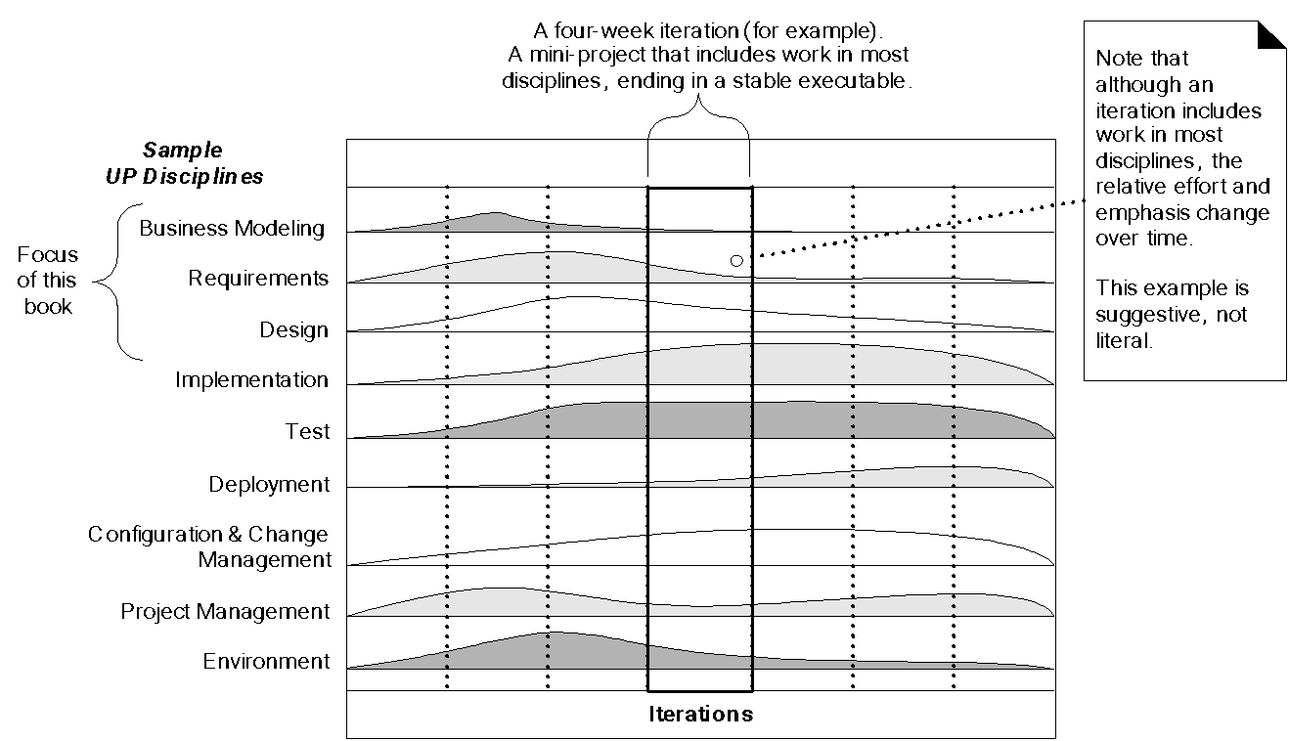
UNIFIED PROCESS disciplines
October 10, 2020
SEWI ZG512 Object Oriented Analysis and Design
5

Slide 6
Waterfall Model Vs Iterative
Chunks
Waterfall by activity
Iterative by subsets of functionalities
Production Quality
Multiple Releases
Incremental, spiral, evolutionary, jacuzzi.
Compromise: Staged Delivery
Time Boxing
Slipping a date or slipping functionality.
October 17, 2020
SEWI ZG512 Object Oriented Analysis and Design
6

Slide 7
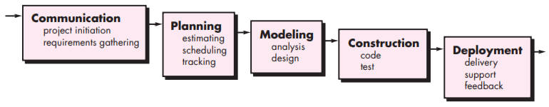
The Waterfall approach

Slide 8
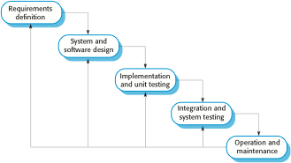
Waterfall Model (Plan-Driven)
Earliest Model (Used only for Large Well-Defined Projects)

Slide 9
Agile Methodology
Effective (rapid and adaptive) response to change
Effective communication among all stakeholders
Drawing the customer onto the team
Organizing a team so that it is in control of the work performed
Yielding …
Rapid, incremental delivery of software

Slide 10
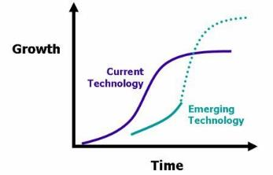
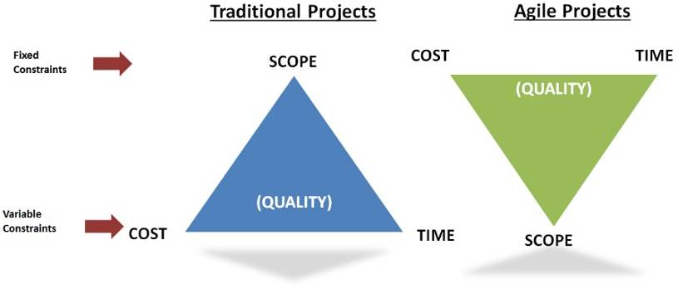
Agile Methods
(Flexible, Adaptive)
Adaptive to Changing or Evolving Customer Requirements
Agility
The ability to both create and respond to change in the business environment
Rigid Processes vs. Agile Frameworks
Being Agile = Competitive, Responsive, Flexible,…

Slide 11
The Manifesto for Agile Software Development
“We are uncovering better ways of developing software by doing it and helping others do it. Through this work we have come to value:
Individuals and interactions over processes and tools
Working software over comprehensive documentation
Customer collaboration over contract negotiation
Responding to change over following a plan
That is, while there is value in the items on the right, we value the items on the left more.”
Kent Beck et al
BSDCH ZC343 - Software Engineering
11

Slide 12
Operational Methodologies:
ITSM (IT Service Management) vs. Service Delivery
SM: Strategic approach to design, deliver, manage and improve the way businesses use information technology (IT).
SM includes all the individual activities and processes that support a service throughout its lifecycle: from service management to change management, problem and incident management, asset management, and knowledge management.
ITSM and IT service delivery sometimes are used interchangeably
ITSM emphasizes IT service operation and improvement
IT service delivery focuses on the quality of the work and meeting customer expectations.
ITIL (Information Technology Infrastructure Library) is a popular ITSM Framework (the terms ITSM and ITIL are used synonymously)
“The implementation and management of quality IT services that meet the needs of the business. IT service management is performed by IT service providers through an appropriate mix of people, process and information technology.” - ITIL

Slide 13
ITSM as a Business Enabler - ITIL
ITSM
Ensure the organization’s business goals are supported by high‐quality, cost‐effective, value‐adding IT services
Improve the quality of IT service provisioning
Reduce the long‐term cost of IT service infrastructure
IT Infrastructure Library (ITIL) is a Framework described in the following volumes:
Service Support
Service Delivery
Security Management
Application Management
ICT Infrastructure Management
Planning to Implement Service Management
The Business Perspective

Slide 14

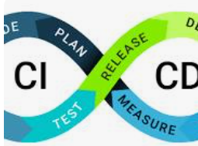

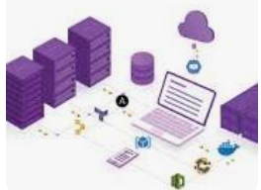

Core Principles of DevOps
Shared responsibility
Automation
Continuous integration and delivery (CI/CD)
Infrastructure as code (IaC)
Monitoring and feedback
Notes:
Shared responsibility: Dev and Ops share ownership of the entire software lifecycle.
Automation: Automate repetitive tasks like testing and deployment to streamline processes.
Continuous integration and delivery (CI/CD): Integrate code changes frequently and automate delivery pipeline for faster releases.
Infrastructure as code (IaC): Treat infrastructure as code for consistent and repeatable deployments.
Monitoring and feedback: Continuously monitor performance and gather feedback for improvement.

Slide 15
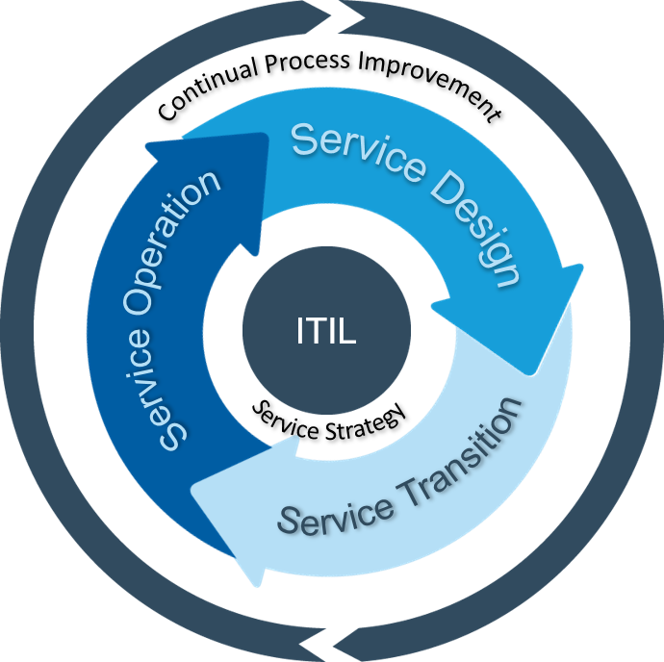
Development, Testing, Release, and Deployment Concepts
Concept of Service Life Cycle
ITIL V3: Five Distinct Stages in ITSM
Service strategy
Service design
Service transition
Service operation
Continual service improvement.

Slide 16
Provisioning, Version Control
Reproducibility.
Traceability.
These capabilities give teams several important benefits:
Disaster recovery.
Auditability.
Higher quality.
Capacity management.
Response to defects.

Slide 17
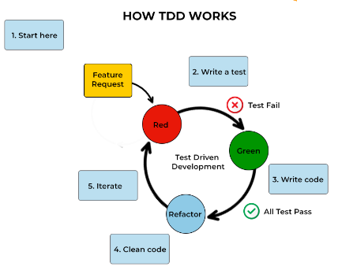
Test Driven Development,

Slide 18
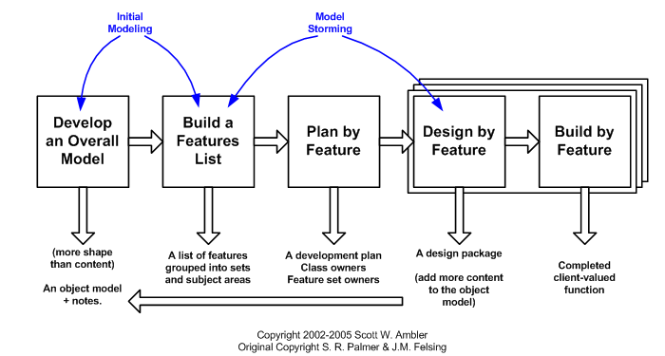
Feature Driven Development

Slide 19
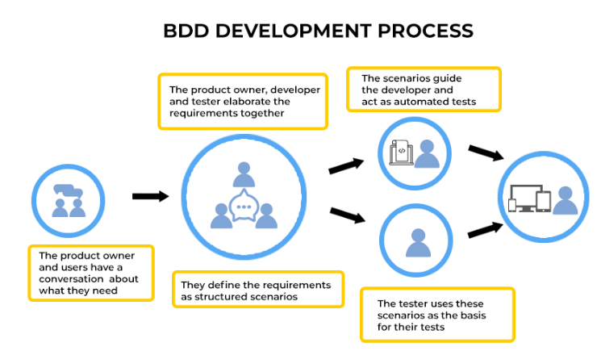
Behavior-driven development

Slide 20




Unleashing the Power of DevOps
Increased speed and agility.
Improved quality and reliability
Enhanced collaboration and communication
Increased innovation
Notes:
Highlight the advantages of adopting DevOps practices:
Increased speed and agility: Deliver software faster and adapt to changing requirements quickly.
Improved quality and reliability: Automate testing and monitoring to produce higher quality software with fewer defects.
Enhanced collaboration and communication: Break down silos between Dev and Ops, fostering a culture of shared goals.
Increased innovation: Focus on development and innovation due to streamlined delivery process.

Slide 21
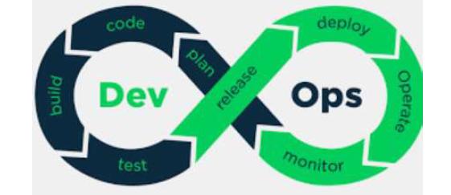
DevOps

Slide 22
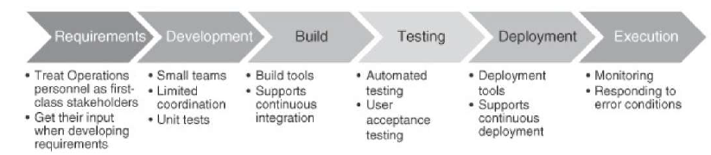
The DevOps Life Cycle

Slide 23


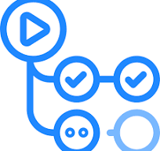
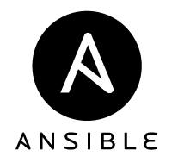
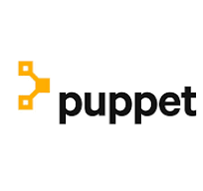


DevOps Toolbelt: Optimizing Your Workflow
Version control systems (VCS)
CI/CD tools
Configuration management tools
Monitoring tools
Notes:
Briefly introduce different DevOps tools categories:
Version control systems (VCS): Manage code changes (e.g., Git).
CI/CD tools: Automate build, test, and deployment pipelines (e.g., Jenkins, GitHub Actions).
Configuration management tools: Manage infrastructure configuration (e.g., Ansible, Puppet).
Monitoring tools: Track application and infrastructure performance (e.g., Prometheus, Grafana).

Slide 24
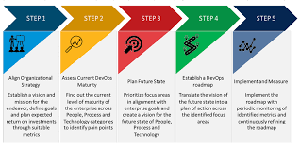
Embrace the DevOps Journey
Assess current state
Define goals
Build a DevOps culture
Adopt DevOps tools
Measure and iterate
Call to action
Notes:
Briefly outline steps for adopting DevOps:
Assess current state: Identify areas for improvement in your software development lifecycle.
Define goals: Set clear goals for DevOps implementation and desired outcomes.
Build a DevOps culture: Foster collaboration and shared responsibility between teams.
Adopt DevOps tools: Select and implement relevant tools based on your needs.
Measure and iterate: Continuously monitor progress and adapt your DevOps practices.
Call to action (Optional): Encourage further exploration of DevOps concepts and resources.

Slide 25
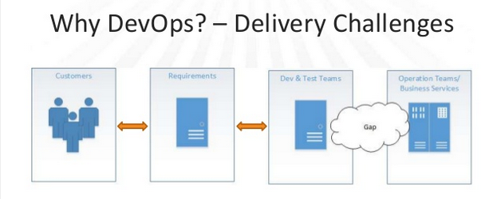
Problems of Delivering Software

Slide 26
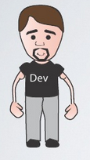
Dev and Ops dialogue
Dev:
Put the current release live, NOW!
It works on my machine
We need this Yesterday
You are using the wrong version
Ops:
What are the dependencies?
No machines available…
Which DB?
High Availability?
Scalability?

Slide 27
Traditional Software Development and Operations Issues
Poor communication between Dev and Ops
Opposing goals
Developers want to push new features
Ops want to keep the system available
It leads to slow-release schedule
Limited capacity of operations staff
Limited insight into operations
Organizations want to reduce time to market for new features, without sacrificing quality
Throw your final version over the fence and let operations worry about running it

Slide 28
Problems of Delivering Software
Deploying Software Manually
Extensive manual to refer and deploy
Prone to human error
Reliance on manual testing
Frequent calls to the development team to explain why a deployment is going wrong on a release day
Frequent corrections to the release process
Releases that take more than a few minutes to perform
Releases and roll back incase of unforeseen problems
Extensive work to the team and solve issues

Slide 29
Problems of Delivering
Deploying to a Production-like Environment Only after Development Is Complete
First deployment to staging is likely to be the most troublesome
longer the release cycle, the longer the development team has to make incorrect assumptions before the deployment occurs, and the longer it will take to fix them
Developers, testers, and operations personnel are constantly raising tickets (or sending emails) to each other to perform any given deployment
Environment incompatibility and bring surprises.
May not have much control over target a1environments, especially outside of a corporate setting. In this case, a great deal of extra testing will be required.

Slide 30
Problems of Delivering Software
Manual Configuration Management of Production
Environments
Operations team take a long time to prepare an environment for a
Release
Cannot step back to an earlier configuration of your system, which
may include operating system, application server, web server, RDBMS, or other infrastructural settings.
Servers in clusters have, unintentionally, different versions of operating systems, third-party infrastructure, libraries, or patch levels
Configuration of the system is carried out by modifying the configuration directly on production systems

Slide 31
Delivering Software- Best pattern to be followed
Deployments should tend towards being fully automated
Automated deployments encourage collaboration, because everything is explicit in a script.
Integrate the testing, deployment, and release activities into the
development process
Testing, staging, and production environments, specifically the configuration
of any third-party elements of your system, should be applied from version
control through an automated process.
Process should be Automated, support Frequent release, Speed deployment, Trigger Feedback for any change.
How to Achieve ?

Slide 32
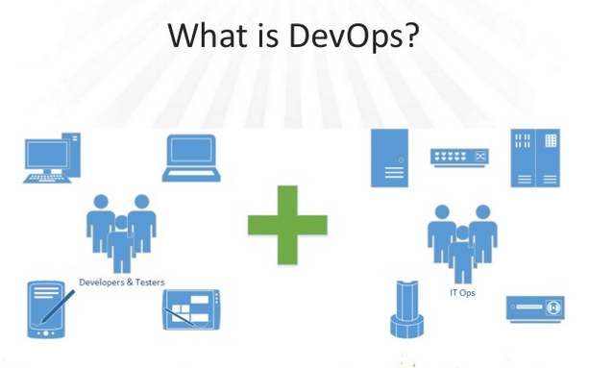
Need for DevOps

Slide 33
DevOps – Development + Operations
Set of principles, practices, and techniques helps to seamless communication, collaboration and integration between software developers and information technology (IT) operation professionals and automate the process.
collaborative way of developing and deploying software
Bridge the gap between build/test and Operations
To create low-risk, frequent, cheap, rapid, and predictable process in software delivery
Create a Repeatable, Reliable Process for Releasing Software
Speed is essential because there is an opportunity cost associated with not delivering software
Bringing “agile” methods to operations

Slide 34
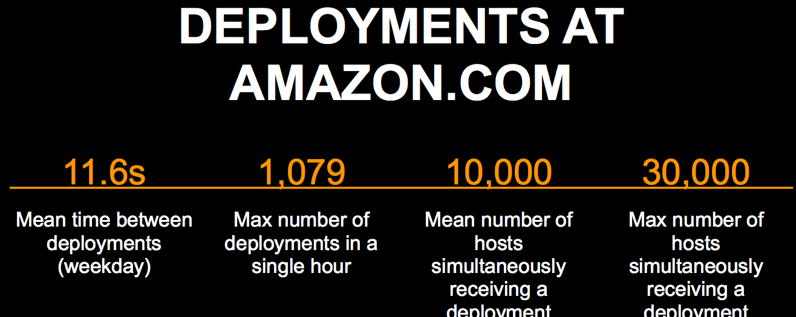
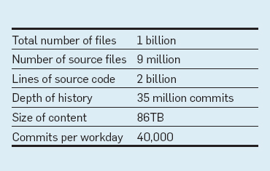

Evolution of DevOps- Example

Slide 35
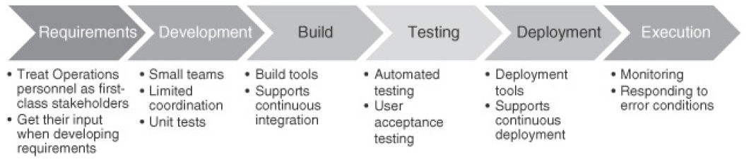
DevOps – Life Cycle
Treat Ops as first-class citizens throughout the lifecycle (Eg. During requirement )
Many decisions can make operating a system harder or easier
Logging and monitoring to suit Ops
Make Dev more responsible for relevant incident handling
Shorten the time between finding and repairing errors

Slide 36
Stages of a DevOps evolution
Normalize the technological stack
Teams have begun adopting true Agile methods and are implementing proper version control as they seek to provide continuous integration and delivery
practitioners must build on a standard set of technologies, and put application configurations in version control
Standardize and reduce variability
Both development and operation teams are working toward one goal - Variability
Teams must work to make sure tech is further consolidated to a single OS or OS family, process complexity is reduced, and early collaboration opportunities are explored
At this stage, system configurations should also be placed in version control and applications should be re-architected to fit business needs

Slide 37
Stages of a DevOps evolution
Develop DevOps practices
Administrative burden must be detected and eliminated so that the teams can work and move faster
Bureaucratic red tape must be eliminated so that individual contributors can do work without approval from outside the team and changes can be made without as much wait time
Collaboration between development and operating teams intensifies
Automate infrastructure delivery
lessen the discrepancy between development's output and operations' delivery times
security configurations, system configurations, and provisioning are automated, the DevOps team can deliver faster and is better set up for future self-service
Agile infrastructure also aims to provide developers with quick access to an environment which is conducive to the deployment of their systems

Slide 38
Stages of a DevOps evolution
Provide self-service capabilities
Many of the self-service capabilities are realized and more resources are made available. Here, application developers can deploy testing environments on their own and success metrics are clearly visible to the team.
Provide self-service capabilities
Teams use “themselves” to progress in their work without administrative constraints
Many of the self-service capabilities are realized and more resources are made available. Here, application developers can deploy testing environments on their own and success metrics are clearly visible to the team.

Slide 39
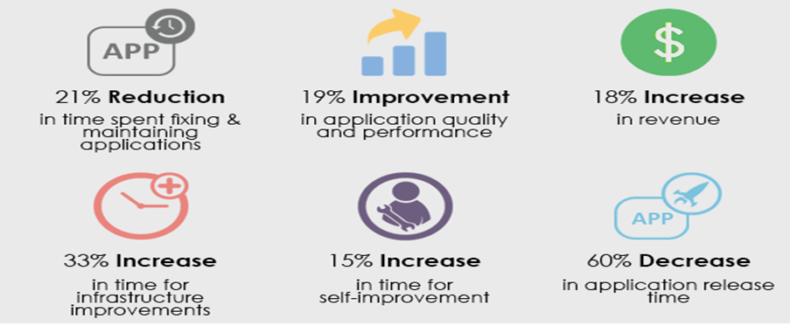
Benefits of DevOps

Slide 40
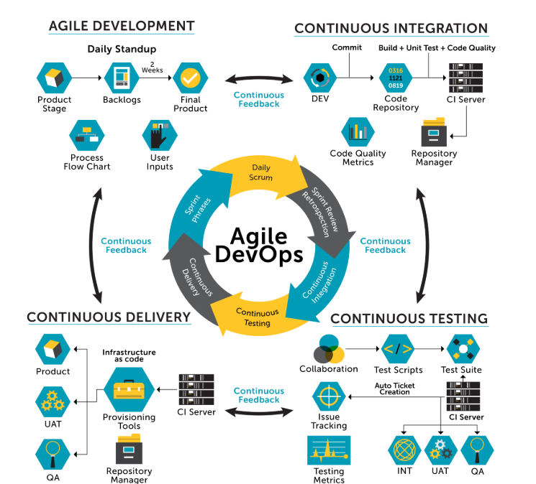
DevOps- Model & Practices

Slide 41
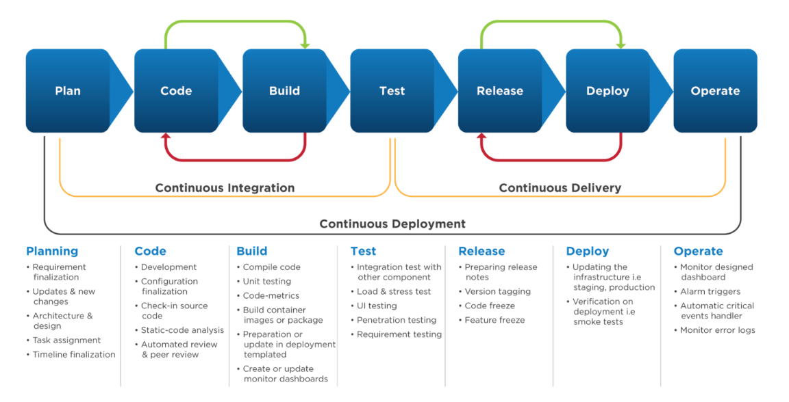
DevOps- Model & Practices

Slide 42
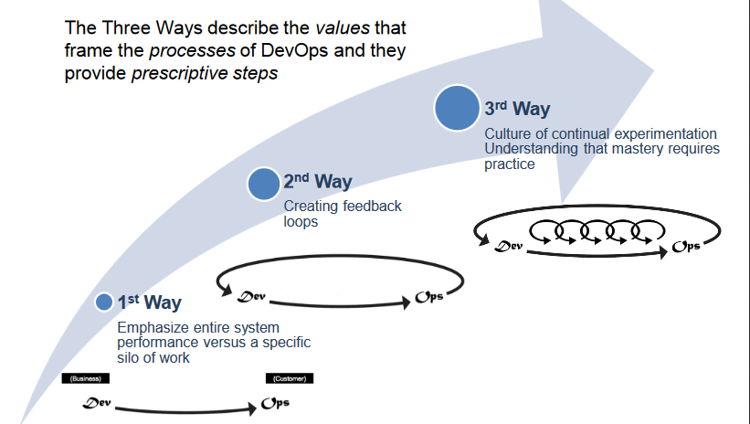
How it works

Slide 43
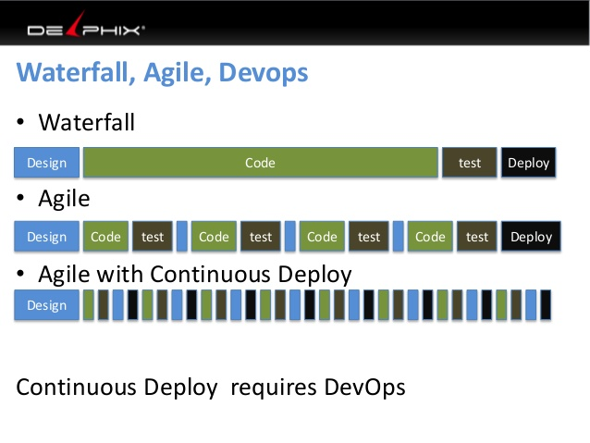
DevOps Culture

Slide 44
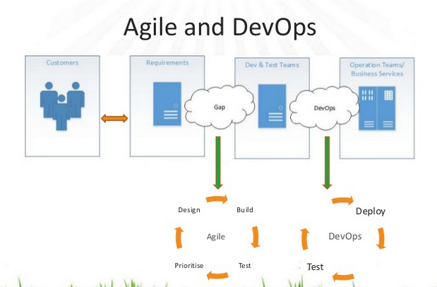
DevOps & Agile

Slide 45
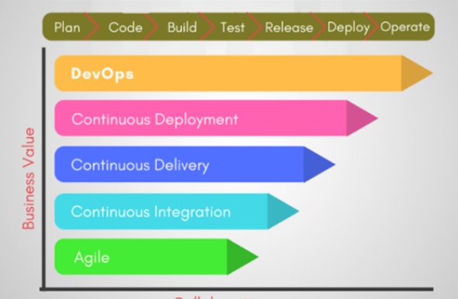
DevOps & Agile
DevOps emphasizes the relationship of DevOps practices to agile
Practices
Agile planning organizes work in short iterations (e.g. sprints) to increase the number of releases
Team has only high-level objectives outlined, while making detailed planning for two iterations in advance. This allows for flexibility and pivots once the ideas are tested on an early product increment.
Close the gap between requirement and build/test

Slide 46
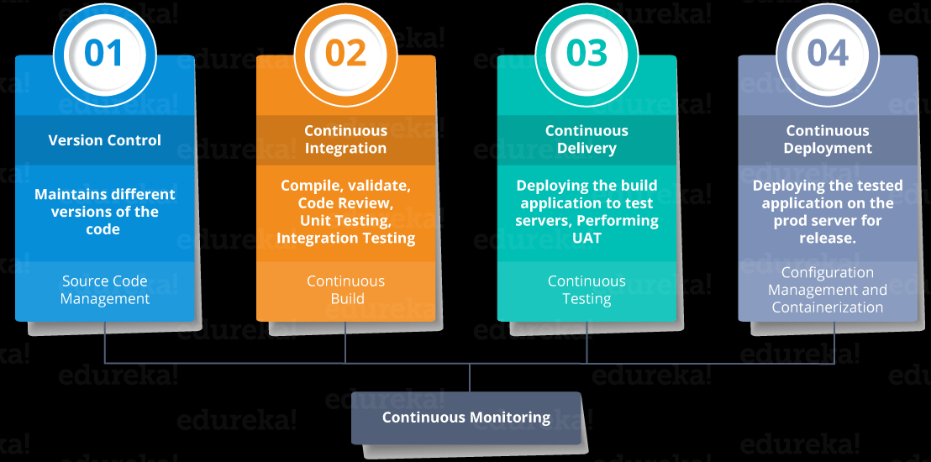
DevOps Lifecycle Processes

Slide 47
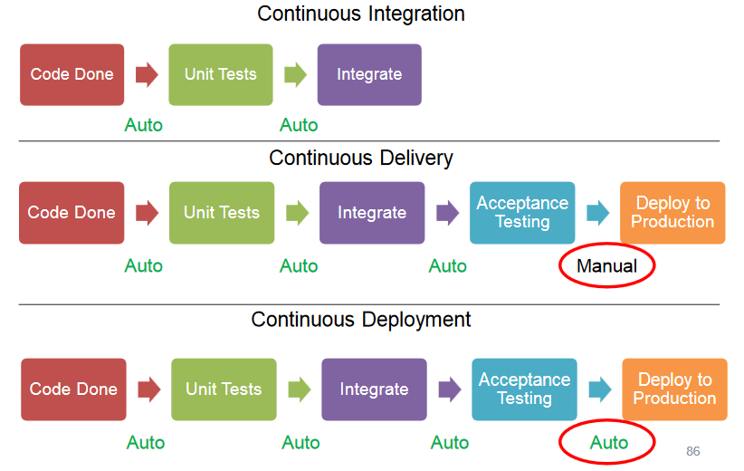
Continuous Integration to Deployment

Slide 48
Continuous Integration
Development practice that requires developers to integrate code into a shared repository several times a day.
If an organization is set up to merge all branching source code together on one day, the resulting work can be tedious, manual, and time-intensive
Developers make code commits multiple times per day
Continuous integration (CI) helps developers merge their code changes back to a shared branch
Each code piece passes through a set of automated tests to detect every error and bug as early as possible
Changes are validated by automatically building the application and running different levels of automated testing, typically unit and integration tests, to ensure the changes haven’t broken the app
the major priority for the development team after the issue is detected is to remove it.

Slide 49
Continuous Inspection
Continuous Inspection is the process of an automated code review of inspection conducted for your code before the actual tests are run
Inspection analyzes the code based on a set of predefined rules.
Inspectors (or static and dynamic analysis tools) are directed by identified standards that teams should adhere to (usually coding or design metrics). Examples of inspection targets include coding “grammar” standards, architectural layering adherence, code duplication, and many others.
Continuous Inspection reduces the time between a discovery and a fix.
Run-Time Defects
Preventative Practices (Code structure, scoping, preprocessor limitations etc.)
Metric Thresholds
Language usage
Style
Portability

Slide 50
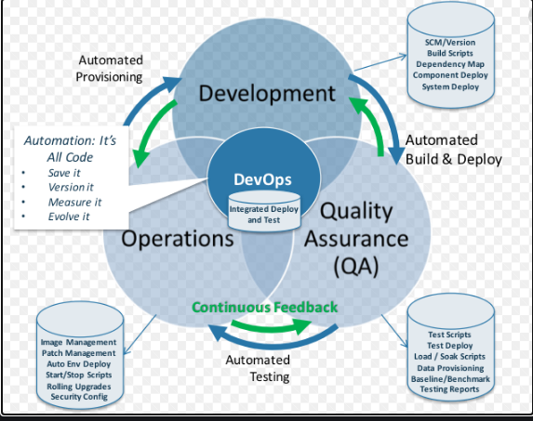
Continuous Deployment

Slide 51
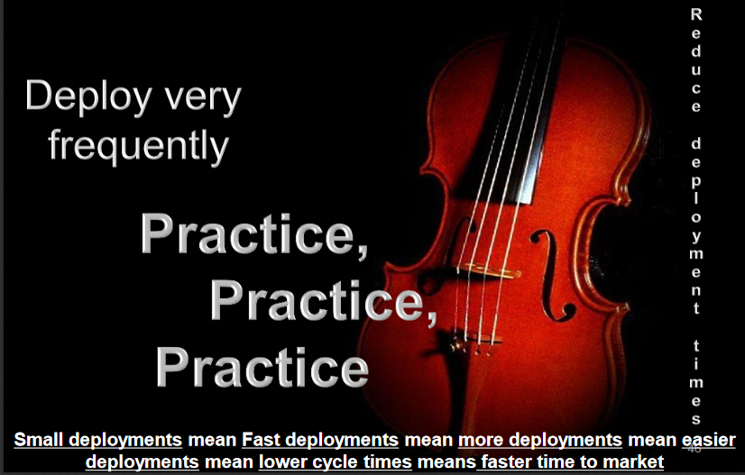
Continuous Delivery

Slide 52
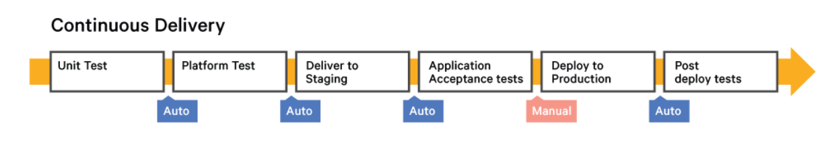
Continuous Delivery
state of being ready and able to release any version at any time on any platform.
Ready to be deployed.
With Continuous Delivery, "Deploy to Production" is a manual process, meaning that it is initiated manually.
Require an Agile process that provides a framework where you work on small, frequent changes and obtain feedback.
Workflow based process which accepts tested software to build payload from CI server. Automate deployment into Working Quality assurance, pre-production or production environment

Slide 53
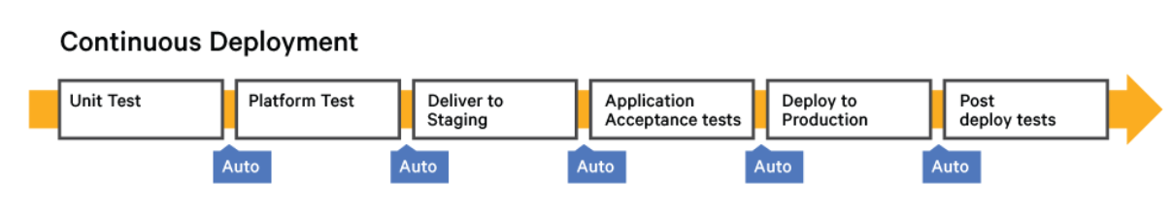
Continuous Deployment
Stage where the code is deployed to the production servers. It is also important to ensure that the code is correctly deployed on all the servers
Require an Agile process that provides a framework where you work on small, frequent changes and obtain feedback.

Slide 54
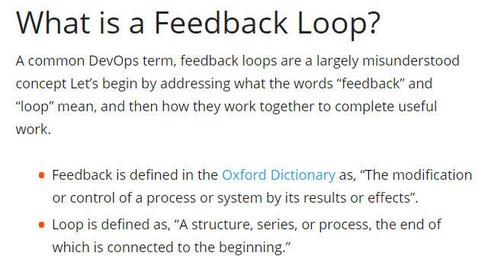
Continuous Monitoring

Slide 55
Continuous Monitoring
The process and technology required to incorporate monitoring across each phase of your DevOps and IT operations lifecycles.
Continuously ensure the health, performance, and reliability of your application and infrastructure as it moves from development to production.
Continuous monitoring builds on the concepts of Continuous Integration and Continuous Deployment (CI/CD) to help develop and deliver software faster and more reliably to provide continuous value to your users.
It is a crucial element in gaining true efficiency and scalability

Slide 56
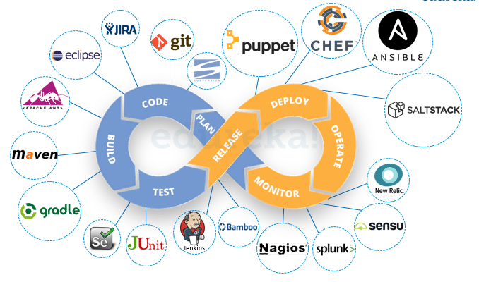
DevOps Tools Example

Slide 57
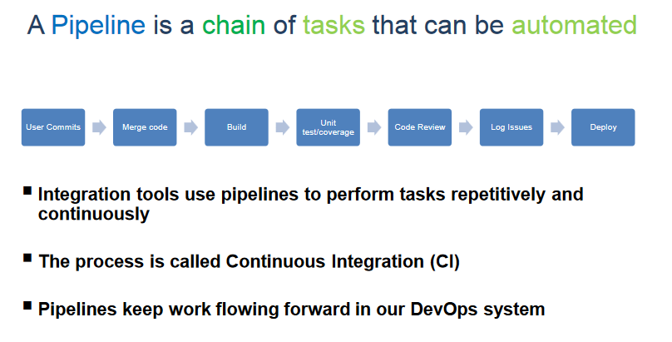
DevOps Pipeline

Slide 58
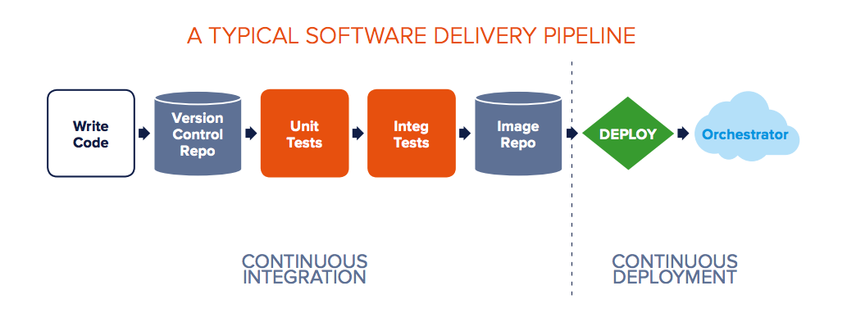

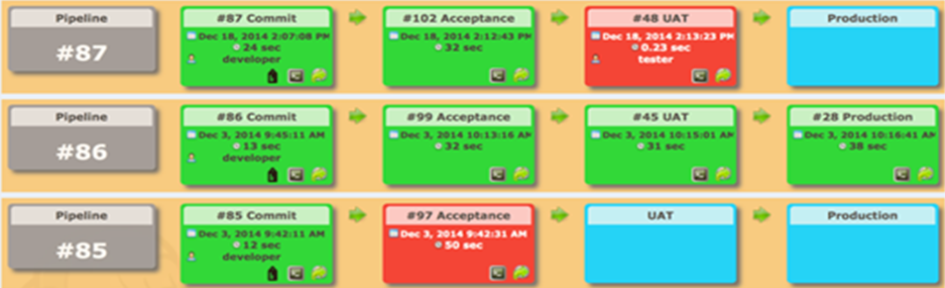

DevOps Pipeline
Delivery pipeline is an automated manifestation of your process for getting software from version control into the hands of your users.
58
Notes:
One of the Big things Agile did was break down the wall between Business and Developers
We’re delivering functional code at the end of each Sprint…
Think Speed in terms of going from Years to Weeks with Agile
58

Slide 59
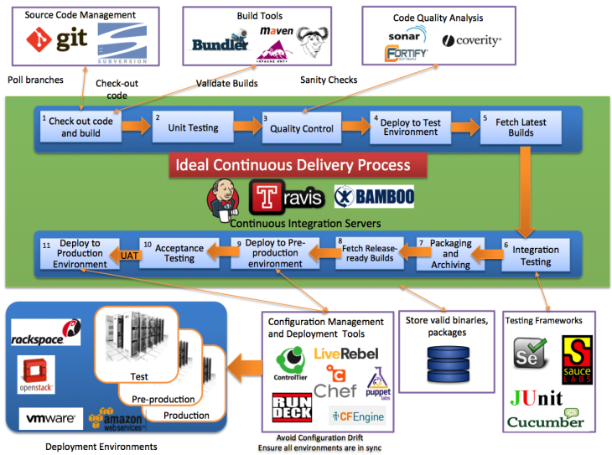
Case Study
DevOps Tools
59
Notes:
One of the Big things Agile did was break down the wall between Business and Developers
We’re delivering functional code at the end of each Sprint…
Think Speed in terms of going from Years to Weeks with Agile
59

Slide 60
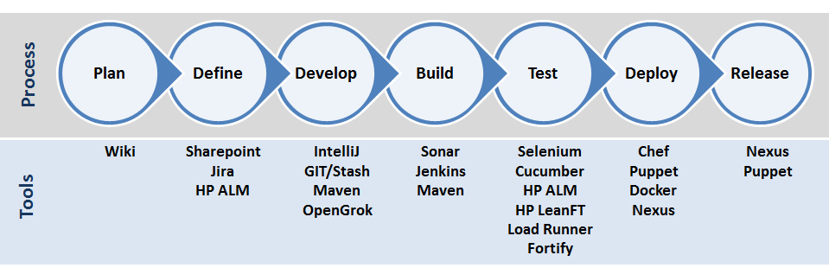
Case Study

Slide 61
Antipatterns
Common Quote “The day of a software release tends to be a tense one”
Antipattern: Deploying Software Manually
The production of extensive and detailed documentation for steps to be performed
Reliance on manual testing
Frequent calls to the development team to explain
Frequent corrections to the release process
Sitting bleary-eyed in front of a monitor at 2 A.M

Slide 62
Antipatterns
Antipattern: Deploying to a Production-like Environment Only after Development Is Complete
Tester tested the system on development machines
Releasing into staging is the first time that operations people interact with the new release
Who Assembles? The Development Team
Collaboration between development and Operations?
Antipattern: Manual Configuration Management of Production Environments
Difference in Deployment to Stage and Production
Different host behave differently
Long time to prepare an environment
Cannot step back to an earlier configuration of a system
Modification to Configuration Directly

Slide 63
Five different categories of DevOps practices
Treat Ops as first-class citizens from the point of view of requirements
Make Dev more responsible for relevant incident handling
Enforce the deployment process used by all, including Dev and Ops personnel
Use continuous deployment
Develop infrastructure code, such as deployment scripts

Slide 64
Principle of Continuous Delivery
Create a Repeatable, Reliable Process for Releasing Software
Automate Almost Everything
Keep Everything in Version Control
If It Hurts, Do It More Frequently, and Bring the Pain Forward
Build Quality In
“The Earlier you catch the defects, the cheaper they are to fix”
Done, Means Released
Everybody Is Responsible for the Delivery Process
Continuous Improvement

Slide 65
Principle of Continuous Delivery
Create a Repeatable, Reliable Process for Releasing Software
Automate Almost Everything
Keep Everything in Version Control
If It Hurts, Do It More Frequently, and Bring the Pain Forward
Build Quality In
“The Earlier you catch the defects, the cheaper they are to fix”
Done, Means Released
Everybody Is Responsible for the Delivery Process
Continuous Improvement

Slide 66
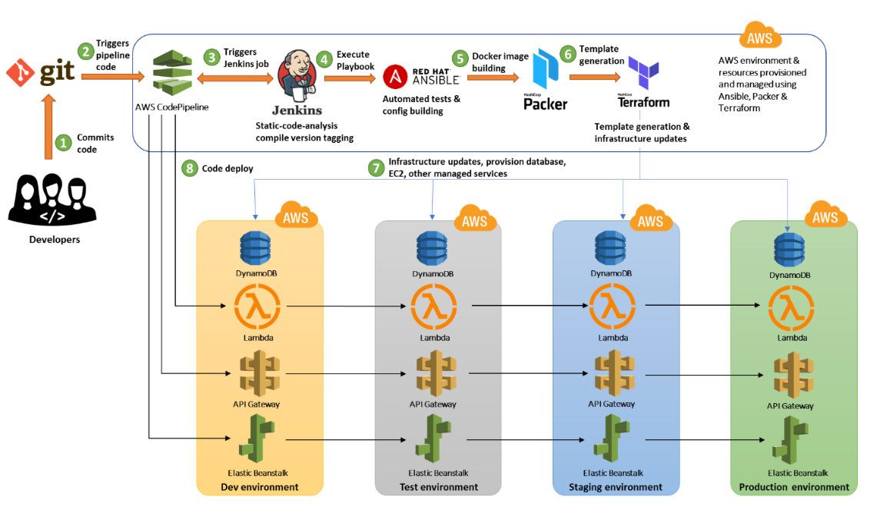
DevOps –AWS Example

Slide 67
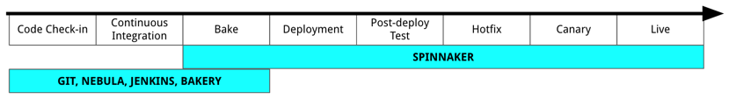
NetFlix
https://netflixtechblog.com/how-we-build-code-at-netflix-c5d9bd727f15

Slide 68
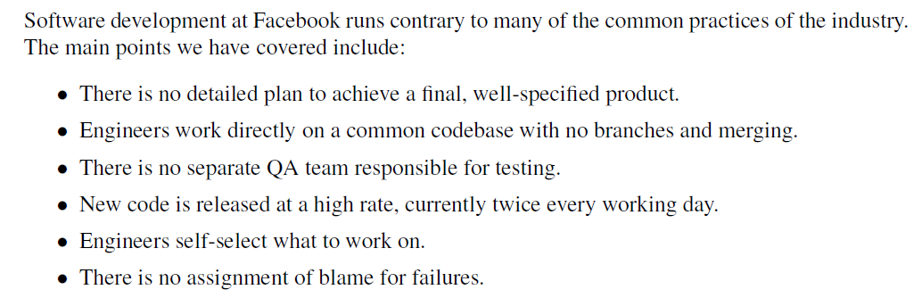
Facebook

Slide 69
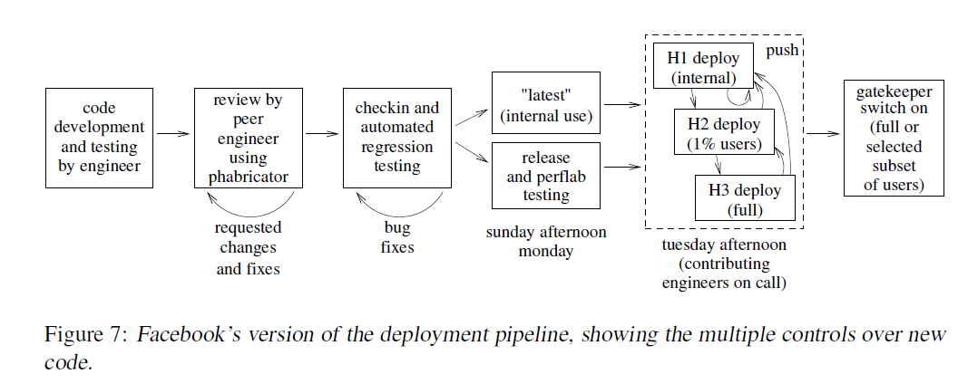
Facebook

Slide 70

The Three Ways: The Principles Underpinning DevOps

Slide 71


DevOps
People
Process
Tools
Culture
Interactions
Automation
Process:
Sequence or layers of procedures that is consisted of people, machines, materials, methods and governing policies that are used all together to design and delivery a good or service (product) . Conversion of an input into an output through-out procedures.
Practice:
Series of steps to achieve a consistent result (output).
A simple process may be described by a single procedure. But a more complex process, will have multiple procedures.

Slide 72
Dimensions of DevOps
Three dimensions of DevOps
People
Initially, stakeholders would need to be identified, ensuring that everybody delivering value to the business are working tightly together on the common goal of adding value to the customer.
Highly motivated people with good collaboration is necessary
Process
Process of designing, building and testing software should be well presented to each individual team member
Processes and practices that help improve the value and delivery to customers
Tools
Tools and services that can help enable different DevOps practices and different teams which can be used to make things easier

Slide 73

Tools
Notes:
One of the Big things Agile did was break down the wall between Business and Developers
We’re delivering functional code at the end of each Sprint…
Think Speed in terms of going from Years to Weeks with Agile
73

Slide 74

Tools
Notes:
One of the Big things Agile did was break down the wall between Business and Developers
We’re delivering functional code at the end of each Sprint…
Think Speed in terms of going from Years to Weeks with Agile
74

Slide 75

Dispelling DevOps Myths
Notes:
One of the Big things Agile did was break down the wall between Business and Developers
We’re delivering functional code at the end of each Sprint…
Think Speed in terms of going from Years to Weeks with Agile
75

Slide 76

Dispelling DevOps Myths
Notes:
One of the Big things Agile did was break down the wall between Business and Developers
We’re delivering functional code at the end of each Sprint…
Think Speed in terms of going from Years to Weeks with Agile
76

Slide 77

Dispelling DevOps Myths
Notes:
One of the Big things Agile did was break down the wall between Business and Developers
We’re delivering functional code at the end of each Sprint…
Think Speed in terms of going from Years to Weeks with Agile
77

Slide 78

Notes:
One of the Big things Agile did was break down the wall between Business and Developers
We’re delivering functional code at the end of each Sprint…
Think Speed in terms of going from Years to Weeks with Agile
78

Slide 79

Dispelling DevOps Myths
Notes:
One of the Big things Agile did was break down the wall between Business and Developers
We’re delivering functional code at the end of each Sprint…
Think Speed in terms of going from Years to Weeks with Agile
79

Slide 80

Dispelling DevOps Myths
Notes:
One of the Big things Agile did was break down the wall between Business and Developers
We’re delivering functional code at the end of each Sprint…
Think Speed in terms of going from Years to Weeks with Agile
80

Slide 81

Dispelling DevOps Myths
Notes:
One of the Big things Agile did was break down the wall between Business and Developers
We’re delivering functional code at the end of each Sprint…
Think Speed in terms of going from Years to Weeks with Agile
81

Slide 82
Food for Thought -
What is the life cycle model followed in your project?
What is your role name?
What are the DevOps tools you use?
Please share your experience
Notes:
One of the Big things Agile did was break down the wall between Business and Developers
We’re delivering functional code at the end of each Sprint…
Think Speed in terms of going from Years to Weeks with Agile
82

Slide 83

ITIL (Information Technology Infrastructure Library)

Slide 84

DevOps System
From Agile to DevOps
Notes:
One of the Big things Agile did was break down the wall between Business and Developers
We’re delivering functional code at the end of each Sprint…
Think Speed in terms of going from Years to Weeks with Agile
84

Slide 85

A Typical Deployment Landscape
Notes:
One of the Big things Agile did was break down the wall between Business and Developers
We’re delivering functional code at the end of each Sprint…
Think Speed in terms of going from Years to Weeks with Agile
85

Slide 86

Test Driven Development
Notes:
One of the Big things Agile did was break down the wall between Business and Developers
We’re delivering functional code at the end of each Sprint…
Think Speed in terms of going from Years to Weeks with Agile
86

Slide 87
DevOps Life Cycle Process -
(Continuous Integration, Continuous Inspection, Continuous Deployment, Continuous Delivery, Continuous Monitoring)

Slide 88
DevOps– Process
Processes define what those people do
Organization can have a great culture of collaboration, but if people are doing the wrong things or doing the right things in the wrong way, failure is still likely.
KEY PROCESSES
(1) As a Business Process
Makes the business more agile and improves its delivery of capabilities to customers.
Business Process defines collection of activities or tasks that produces a specific result (service or product) for customers.
DevOps business process involves taking capabilities from the idea (typically identified with business owners) through development and testing to production.
Business process isn’t mature enough to be captured in a set of simple process flows. Need to identify areas of improvement , both by improving the processes themselves and by introducing automation.

Slide 89
DevOps– Process
(2) Change management process
Set of activities designed to control, manage, and track change by identifying the work products that are likely to change and the processes used to implement that change.
Traditional change management approaches tend to be limited to change request or defect management, with limited capability to trace the events between the change requests or defects and the associated code or requirements.
Requires all stakeholders to be able to view and collaborate on all changes across the software development life cycle
Organization uses is an inherent part of the broader DevOps process flow.
Change management should include processes
Work-item management
Configurable work-item workflows
Project configuration management
Planning (agile and iterative)
Role-based artifact access control

Slide 90

Agile methodologies for effective DevOps
Disciplined Agile Delivery phases for each release.
Inception phase – Release planning (Feature prioritization, scheduling) and initial requirements
Construction phase – management of the code branches, the use of continuous integration and continuous deployment
Transition phase - solution is deployed and the development team is responsible for the deployment, monitoring the process of the deployment, deciding whether to roll back and when
Choosing appropriate Team Size - size of the team should be relatively small
Team Roles - Team lead (Scrum Master) Team member (Developer)
-

Slide 91

Agile Vs DevOps
91
Notes:
One of the Big things Agile did was break down the wall between Business and Developers
We’re delivering functional code at the end of each Sprint…
Think Speed in terms of going from Years to Weeks with Agile
91

Slide 92

Agile Vs DevOps
Notes:
One of the Big things Agile did was break down the wall between Business and Developers
We’re delivering functional code at the end of each Sprint…
Think Speed in terms of going from Years to Weeks with Agile
92

Slide 93

Scrum
Notes:
One of the Big things Agile did was break down the wall between Business and Developers
We’re delivering functional code at the end of each Sprint…
Think Speed in terms of going from Years to Weeks with Agile
93

Slide 94

Test Driven Development
Notes:
One of the Big things Agile did was break down the wall between Business and Developers
We’re delivering functional code at the end of each Sprint…
Think Speed in terms of going from Years to Weeks with Agile
94

Slide 95

Scrum vs Kanban (Non flow vs flow based)
Velocity measures completed stories per iteration. The unit is work per time, e.g. 4 stories per 2 week iteration.
Cycle time measures the amount of time passed working on a story.
Notes:
One of the Big things Agile did was break down the wall between Business and Developers
We’re delivering functional code at the end of each Sprint…
Think Speed in terms of going from Years to Weeks with Agile
95

Slide 96
Iteration- and Flow-Based Agile
Iteration based Agile
Requires an initial prioritization of features, which then allows the team to start work by progressing from the highest priority feature down to the lowest.
The iterations are regularly spaced out in constant, equal intervals (thus the name) which then builds up a cycle that the team becomes familiar with.
A single iteration may have multiple features, but features will be carried over to the next iteration if it is incomplete.
Flow based Agile
Team assesses the features backlog and then decide on which feature to work on based on their available capacity.
Since there is no fixed time interval for releases, the team together with the stakeholders will need to decide on a schedule for planning, review and testing.

Slide 97
Enterprise Agile Frameworks
Aims to scale Agile principles and practices to the enterprise, and address the specific challenges of managing a large number of Agile large-size teams
How to apply methodologies such as Scrum or Kanban which are designed for small teams, to organizations that count hundreds of teams, teams-of-teams, or even teams-of-teams-of-teams
SAFe - Scaled Agile Framework
DAD - Disciplined Agile Delivery
Nexus
LeSS Huge - Large Scale Scrum

Slide 98
TDD, FDD, BDD
TDD (Test Driven Development)
Writing a test first, watching it fail then writing enough of the implementation to make it pass then re-factor originally seemed like an alien concept that was going to make the development process longer
How functionality implemented?
FDD (Feature Driven Development)
splitting up a project into features but involves prioritization and planning
Think about and begin modelling a system before any development begins
BDD (Behavior Driven Development)
BDD is an extension upon TDD and does not contest the fundamental values of TDD.
Process starts by writing a scenario as per the expected behavior.
BDD, a test is written that can satisfy both the developer and customer.
How application implemented?

Slide 99

TDD, FDD, BDD

Slide 100

TDD- Test Driven Development

Slide 101

TDD- Test Driven Development

Slide 102

FDD - Feature Driven Development
Notes:
One of the Big things Agile did was break down the wall between Business and Developers
We’re delivering functional code at the end of each Sprint…
Think Speed in terms of going from Years to Weeks with Agile
102

Slide 103

BDD – Behaviour Driven Development

Slide 104

BDD – Behaviour Driven Development

Slide 105

BDD – Behaviour Driven Development

Slide 106
DevOps– Practices
Key DevOps Practices
Release planning
Continuous integration
Continuous delivery
Continuous testing
Continuous monitoring and feedback

Slide 107
DevOps– Practices
1. Release planning
Release planning is a critical business function, driven by business needs to offer capabilities to customers and the timelines of these needs.
Businesses require well defined release planning and management processes that drive release roadmaps, project plans, and delivery schedules, as well as end-to-end traceability across these processes.
Traditionally, release planning accomplished by using spreadsheets and holding meetings (often, long ones) with all stakeholders across the business to track all business needs applications under development, their development status, and release plans.
Well-defined processes and automation, however, eliminate the need for those spreadsheets and meetings, and enable streamlined and enable predictable releases.

Slide 108
DevOps– Practices
2. Continuous integration
Allowing large teams of developers, working on cross-technology components in multiple locations, to deliver software in an agile manner.
Each team’s work is continuously integrated with that of other development teams and then validated.
Continuous integration reduces risk and identifies issues earlier in the software development life cycle.
3. Continuous Delivery/Deployment
Continuous integration naturally leads to the practice of continuous delivery/deployment
Process of automating the deployment of the software to the testing, system testing, staging, and production environments.
Automated process in all environments to improve efficiency and reduce the risk introduced by inconsistent processes

Slide 109
DevOps– Practices
4. Continuous Delivery/Deployment
Processes that they adopt may vary from project to project, based on individual testing needs and on the requirements of service level agreements.
Adopt processes in three areas:
Test environment provisioning and configuration
Test data management
Integration, functional, performance, and security testing

Slide 110
DevOps– Practices
5. Continuous monitoring and feedback
Customer feedback comes in different forms, such as tickets opened by customers, formal change requests, informal complaints, and ratings in app stores.
Feedback also comes from monitoring data. This data comes from the servers running the application; from Development, QA, and Production; or from metrics tools embedded in the application that capture user actions.
Businesses need well-defined processes to absorb the feedback from myriad sources and incorporate them into software delivery plans.

Slide 111
DevOps– Practices
6. Continuous Improvement
Process adoption isn’t a one-time action, but an ongoing process.
An organization should have built-in processes that identify areas for improvement as the organization matures and learns from the processes it has adopted.
Many businesses have process improvement teams that work on improving processes based on observations and lessons learned.
Teams that adopt the processes to self-assess and determine their own process improvement paths.

Slide 112
DevOps– Tools
Enables people to focus on high-value creative work while delegating routine tasks to automation. Technology also allows teams of practitioners to leverage and scale their time and abilities.
Organization has to reuse assets, code, and practices to be cost-effective and efficient.
Standardizing automation also makes people more effective
common set of tools allows practitioners to work anywhere, and new team members need to learn only one set of tools and a process that’s efficient, cost-effective, repeatable, and scalable.
Categorized into major areas are
Infrastructure as Code
Delivery Pipeline
Deployment automation and release management

Slide 113
DevOps– Cloud as a catalyst
Cloud is key enabler and has affected DevOps. It helps DevOps to mature.
In traditional organizations that use physical servers, requesting a new server is a complex, time-consuming process. It may take days or even weeks to requisition a new physical server, install and set up the operating system (OS), and configure all the software required to deploy the application.
Pervasiveness of cloud technology, private, public, and hybrid, has enabled organizations to provision environments on demand.
Virtualization in Cloud solve that problem to a large extent. This has led to tremendous growth in the scale by which the environments to which
applications are deployed are used.
This scale has necessitated automation on software deployment tasks, which DevOps addresses
Ability to create and switch environments simply, the ability to create VMs
easily, and the management of databases etc..

Slide 114
DevOps– Cloud as a catalyst
Advent of cloud actually facilitates continuous deployment and provides easier access to production like environments during the development and testing stages of the delivery pipeline.
Developer can not only invoke an automated build, but also request the provisioning and configuration of a production like environment in the cloud and then deploy the application being built to it without any direct involvement by the operations team.

Slide 115

What is DevOps?
DevOps is a software development method that stresses communication, collaboration and integration between software developers and information technology (IT) operation professionals.

Slide 116
Roles In DevOps
Team Lead / Project lead / Scrum Master
Team Member
Scrum Master
Additional Roles
Service owner
Reliability engineer
Gatekeeper
And DevOps engineer
Notes:
Team lead :
This role you can relate to “Scrum Master” of SCRUM TEAM.
Also you can relate to Project Lead
Is responsible:
For facilitating the team
Obtaining resources for it
And protecting it from problems
This role encompasses the soft skills of project management but not the technical ones such as planning and scheduling, activities which are better left to the team as a whole.
Team member
This role, sometimes referred to as developer or programmer
Is responsible for the creation and delivery of a system
This includes modeling, programming, testing, and release activities, as well as others

Slide 117
Focuses on
Small teams
The size of the team should be relatively small
Amazon has a “two pizza rule” (2 pizzas should suffice the team)
The advantages of small teams are
Quick decision making, allows speaking up
Team members who are to be motivated, take ownership
The disadvantage
Large tasks – May have to be accomplished by a small number of resources
Task has to be broken up into smaller pieces
A small team, by necessity, works on a small amount of code
- Individuals and Interactions as opposed to Processes & tools
- Working software as opposed to Documentation
- Customer collaboration as opposed to Contracts
- Responding to change as opposed to Extensive planning

Slide 118
Component vs Feature teams
Component
Time elapsed
Expertize in UI, M/W and DB – Each acting as a silo
Feature teams
Multi faceted individuals who can work in any area of system
At least 1 team member who has specialist knowledge for each layer of system
Allow teams to work on vertical slices of system
Notes:
Feature teams are long lived, jell together, co located, usually work on a complete customer centric feature

Slide 119
Food for thought
Have your developers spend the weekend with operations, watching a production rollout and learning what they go through.
Likewise, track how many steps or service tickets it takes for a developer to request a new virtual system.

Slide 120
7Cs of DevOps
Communication
Collaboration
Controlled Process
Continuous Integration
Continuous Deployment
Continuous Testing
Continuous Monitoring
Notes:
CONTINUOUS Integration
New functionalities are integrated with the prevailing code, and testing of new code takes place. Continuous integration and testing help in the continuous development process.
CONTINUOUS Deployment
Continuous deployment is the part of DevOps lifecycle. When it is performed in the right way, then it can affect the overall functioning of a high traffic website.

Slide 121
People Dimension
Regular 1 o 1
Feedback
Blameless culture!!
Can you measure org culture?
Tools
Local Dev Environment
Version Control
Artifact management
Automation tools – Server installation, Configuration management
System provisioning
Test & build automation
Notes:
30 mins 1 o 1, open door policy is good… but at least have 1 o 1 with each team member,
Org culture –– Info is actively sought, failures are learning opportunities, failure causes enquiry, collaboration is encouraged and rewarded, new ideas are encouraged.. Team members feel they belong … “I would recommend my team to my friends, will not like to leave my team, I have the tools to do my job well, my role uses my skills and capabilities”
Robust End user devices will help: Multiple displays, high resolution, Consistent dev environment, ability to share / store documentation, specific keyboards, mice and other equipment
Version control – avoids conflicts of having multiple people working on same file and also roll back… if needed… can it increase collaboration?
An artifact is the output of any step in the software dev process
Is the artifact repository secure, trusted, versioned, accessible, stable?
You can store a versioned common lib separate from software version control so that the library can be used by other teams as well
(Puppet, chef), capacity management – sizing servers, infra sized for current and future needs…. Now Data center VS cloud (on demand computing), scale up and scale down as needed, pay as use,
Test automation, regression testing, usability, scheduled testing

Slide 122

DevOps Features
Notes:
Automation
Automation can reduce time consumption, especially during the testing and deployment phase. The productivity increases, and releases are made quicker by automation. This will lead in catching bugs quickly so that it can be fixed easily. For contiguous delivery, each code is defined through automated tests, cloud-based services, and builds. This promotes production using automated deploys.
2) Collaboration
The Development and Operations team collaborates as a DevOps team, which improves the cultural model as the teams become more productive with their productivity, which strengthens accountability and ownership. The teams share their responsibilities and work closely in sync, which in turn makes the deployment to production faster.
3) Integration
Applications need to be integrated with other components in the environment. The integration phase is whore the existing code is combined with new functionality and then tested. Continuous integration and testing enable continuous development. The frequency in the releases and micro-services leads to significant operational challenges. To overcome such problems, continuous integration and delivery are implemented to deliver in a quicker, safer, and reliable manner.
4) Configuration management
It ensures the application to interact with only those resources that are concerned with the environment in which it runs. The configuration files are not created where the external configuration to the application is separated from the source code. The configuration file can be written during deployment, or they can be loaded at the run time, depending on the environment in which it is running.

Slide 123

DevOps Phases
Notes:
The main principles of DevOps are Continuous delivery, automation, and fast reaction to the feedback.
End to End Responsibility: DevOps team need to provide performance support until they become the end of life. It enhances the responsibility and the quality of the products engineered.
Continuous Improvement: DevOps culture focuses on continuous improvement to minimize waste. It continuously speeds up the growth of products or services offered.
Automate Everything: Automation is an essential principle of the DevOps process. This is for software development and also for the entire infrastructure landscape.
Custom Centric Action: DevOps team must take customer-centric for that they should continuously invest in products and services.
Monitor and test everything: The DevOps team needs to have robust monitoring and testing procedures.
Work as one team: In the DevOps culture role of the designers, developers, and testers are already defined. All they needed to do is work as one team with complete collaboration.
These principles are achieved through several DevOps practices, which include frequent deployments, QA automation, continuous delivery, validating ideas as early as possible, and in-team collaboration.

Slide 124

DevOps Lifecycle Components

Slide 125
DevOps Components
Plan
DevOps use Agile methodology to plan the development With the operations and development team in sync, it helps in organizing the work to plan accordingly to increase productivity
Build
DevOps, the usage of cloud, sharing of resources comes into the picture, and the build is dependent upon the user's need, which is a mechanism to control the usage of resources or capacity.
Code
Many good practices such as Git enables the code to be used, which ensures writing the code for business, helps to track changes, getting notified about the reason behind the difference in the actual and the expected output, and if necessary reverting to the original code developed. The code can be appropriately arranged in files, folders, etc. And they can be reused

Slide 126
DevOps Components
Test
The testing can be automated, which decreases the time for testing so that the time to deploy the code to production can be reduced as automating the running of the scripts will remove many manual steps.
Monitor
Continuous monitoring is used to identify any risk of failure. Also, it helps in tracking the system accurately so that the health of the application can be checked. The monitoring becomes more comfortable with services where the log data may get monitored through many third-party tools such as Splunk.

Slide 127
DevOps Components
Deploy
Many systems can support the scheduler for automated deployment. The cloud management platform enables users to capture accurate insights and view the optimization scenario, analytics on trends by the deployment of dashboards
Operate
DevOps changes the way traditional approach of developing and testing separately. The teams operate in a collaborative way where both the teams actively participate throughout the service lifecycle. The operation team interacts with developers, and they come up with a monitoring plan which serves the IT and business requirements

Slide 128
Why do you want to transform?
The intent is to transform the way solutions are being delivered today and to do it faster, cheaper and better
The techniques of Agile and DevOps have been successfully implemented in many large and small organizations to enable those outcomes

Slide 129
Devops – As an Agile enabler
Gartner defines: A business driven approach to deliver customer value by using Agile Methods, collaboration and automation
Eco system of Agile methodology, DevOps, increased focus on collaboration = Customer Experience
Notes:
We are the business
Culture change… most important and most difficult (Delivering code is worthless, maturity alone is worthless, aim to become a valued business partner
50% issues in Devops projects are people issues as per a McKinsey study
Continuous improvement – continuous improvement, theory of constraints, lean and systems thinking
Agile methods
Automation

Slide 130
Transforming the Enterprise - DevOps
Current state of DevOps maturity
Assess
Define the Desired State
Develop a transformation plan
Implement the transformation plan
Measure and monitor progress
Key challenges
Cultural change
Process change Technology change:
investment in new tools and technologies.
Notes:
Cultural Change: DevOps requires a shift from a siloed to a collaborative culture.
Process change: DevOps requires changes to existing development and operations processes.
Key challenges:
Organization Structure
Legacy Technology Stack
Organization Culture

Slide 131
Infrastructure as Code
IT Departments have been busy providing IT solutions for their customers, but they forgot their own backyard
IT departments themselves became bottlenecks
No one was trying to automate the IT Environment itself
Notes:
Therefore can leverage development techniques for collaboration, deployment and integration

Slide 132
Infrastructure as Code
“Infrastructure as code represents the idea that everything that needs to run as infrastructure can be considered as software”
Notes:
Therefore can leverage development techniques for collaboration, deployment and integration

Slide 133



Infrastructure as Code
Notes:
Therefore can leverage development techniques for collaboration, deployment and integration

Slide 134
Infrastructure as Code
Infrastructure as code (IaC) is an IT practice that uses programming languages and machine-readable code to manage and configure computing infrastructure
Minimize manual configuration
IaC helps developers and operations teams automatically manage, monitor, and provision resources, and improve infrastructure consistency, security, automation, and performance
Notes:
In an Enterprise Environment – there are many physical, virtual servers (web servers, app servers, DB servers, File servers etc).. They do different things and run different packages. It sometimes is difficult to keep track of the software installed on each machine… tahs where IAC comes in

Slide 135

What is the impact?

Slide 136

DevOps stack
Notes:
Infrastructure Automation
Amazon Web Services (AWS): Being cloud service you do not need to be physically present in the data center. Also, they are easy to scale on-demand. There are no up-front hardware costs. It can be configured to provision more servers based on traffic automatically.
Configuration Management
Chef: It is a useful DevOps tool for achieving speed, scale, and consistency. It can be used to ease out complex tasks and perform configuration management. With this tool, DevOps team can avoid making changes across ten thousand servers. Instead, they need to make changes in one place which is automatically reflected in other servers.
Deployment Automation
Jenkins: This tool facilitates continuous integration and testing. It helps to integrate project changes more easily by quickly finding issues as soon as a built is deployed.
Log Management
Splunk: This is a tool solves the issues like aggregating, storing, and analyzing all logs in one place.
Performance Management
App Dynamic: It is DevOps tool which offers real-time performance monitoring. The data collected by this tool helps developers to debug when issues occur.
Monitoring
Nagios: It is also important to make sure people are notified when infrastructure and related services go down. Nagios is one such tool for this purpose which helps DevOps teams to find and correct problems.

Slide 137






































Visual Studio Partners and Extensions
65
Visual Studio Code Extensions
5,910
Visual Studio Gallery Extensions
90
Visual Studio Sim-Ship Partners
48
VS Team Services Extensions

Slide 138
Deployment Pipeline
The purpose of a pipeline is to transport some resource from point A to point B effectively with minimum upkeep or attention required once built
The purpose of a build pipeline is to transport the code from a developer machine or environment to an environment quickly and effectively with minimum upkeep or attention required once built

Slide 139

Deployment Pipeline

Slide 140
Deployment Pipeline
Build pipelines require measurements and verification to ensure
The Product is high quality
Meets the Standards
Promotion pipeline
The promotion pipeline promotes inventory entries from one environment to another and creates a promotion pull/merge request.
Notes:
This logical deployment pipeline is made up of two pipelines: Build Pipeline and Promotion
Pipeline.
Build Pipeline
The build pipeline represents the steps to ensure code quality of the Merge Request. For deployable code (applications, services

Slide 141
Deployment Pipeline benefits
Improved Developer Experience
Delivering Software At An Agile Pace
Continuous/Fast Feedback
Approvals To Audit
Secure At The Start
Automated testing
Industry Standard Best Practices
Improved time to value through code enabled deployments
Reduced support footprint due to consistent deployments
Simple automated deployments to any target zone
Automation, Automation, Automation
Notes:
Definition: The deployment pipeline is a logical process of migrating source code checked into a
version control system and delivering a fully tested, compliant application to production. A stage of
the pipeline represents a specific function that produces output used to drive subsequent pipeline
stages. For example, a build stage will produce an immutable artifact used for testing and eventual
deployment. Each stage of the pipeline is as fully automated as possible; however, stage gates
may exist to ensure approval before moving among stages. Code reviews and QA approvals before
moving to the next environment are examples of pipeline stage gates. These manual steps may be
required to meet compliance or due to manual test scenarios.

Slide 142
Cloud is no longer a mystery
Not quite!!
Not the concept of the cloud but why they are not seeing the benefits that were promised to them
The focus is on adopting cloud-based infrastructure and managing it
While we will discuss cost benefits primarily, one should not forget the other benefits and risks of the cloud
Benefits:
Redundancy for resilience
The scalability of resources
The strong ecosystem of related
Risks:
The dependency on a third-party provider
The challenges with data sovereignty
Risk of being attacked because you are on a popular platform

Slide 143

Cloud is no longer a mystery
Cloud computing metaphor: the group of networked elements providing services need not be individually addressed or managed by users; instead, the entire provider-managed suite of hardware and software can be thought of as an amorphous cloud.

Slide 144
Cloud – Providing IT capabilities as a service
Notes:
This is the 2nd decade of Cloud computing and unfortunately though it has been a long time into Cloud, there is lot of confusion.
Consumer view, provider view and perhaps a broker view.. But it essentially is a scalable. And elastic IT capabilities provided as a Service using internet technologies…
Different kinds of services and models Typical characteristics: sharing of services, using of internet, scalability, elasticity
Cloud is being adopted in a big way

Slide 145
Centralized Version Control Systems
A centralized version control system offers software development teams a way to collaborate using a central server.
A server acts as the main centralized repository which stores every version of code.
Using centralized source control, every user commits directly to the main branch, so this type of version control often works well for small teams, because team members have the ability to communicate quickly so that no two developers want to work on the same piece of code simultaneously
As a client-server model, a centralized workflow enables file locking so that any piece of the code that's currently checked out will not be accessible to others, ensuring that only one developer can contribute to the code at a time. Team members use branches to contribute to the central repository, and the server will unlock files after merges.

Slide 146
Distributed Version Control Systems
A distributed version control system (DVCS) brings a local copy of the complete repository to every team member’s computer, so they can commit, branch, and merge locally. The server doesn’t have to store a physical file for each branch — it just needs the differences between each commit.
Distributed source code management systems, such as Git, Mercurial, and Bazaar, mirror the repository and its entire history as a local copy on individual hard drives.
Distributed version control systems help software development teams create strong workflows and hierarchies, with each developer pushing code changes to their own repository and maintainers setting a code review process to ensure only quality code merges into the main repository.
A contributor can no longer rely on a server to resolve conflicts when merging and has to resolve them locally, which can result in confusing merge commits. However, despite the initial discomfort, a distributed source control system can ensure stable code development when multiple developers contribute to software development projects.

Slide 147
Introducing GitHub
A web-based hosting and collaboration platform used by professional programmers to develop new software.
Professional who uses GitHub can create and manage software with the advanced platform.
The largest and most advanced global collaboration
platform where developers and companies build and maintain
their software using the Git version control tool.
Used by software engineers, programmers, developers, instructors, and coding students to build unique code.

Slide 148
Continue-GitHub Intro
The biggest source code host with over 200 million repositories.
Storage space where your projects are stored.
Companies and professionals host, store and record their code in the Github cloud.
Hosting is free with an unlimited private and public remote repository.
Users can take advantage of the benefits of version history with revision control. This feature, along with pull requests, make collaboration on code files transparent and easier to trace.

Slide 149
Why Gut Hub Is popular
Github started as a small startup company in 2008 and made it to Forbe’s Unicorn List of companies , valued at more than $1 billion in a little over ten years.
Some facts that support Github’s surge in popularity over the years.
Second leading traffic referrers to LinkedIn worldwide 2021 . As of June 2021, Github generated more than 5.09% of the referral traffic to LinkedIn.
84% of Fortune 100 companies use Github Enterprise . Many big companies have seen the advantages of using Github Enterprise to help streamline their security, administration, and collaboration efforts.

Slide 150
Why Gut Hub Is popular
73 million software developers are using Github . The company had 56 million users in December 2020, but the community just keeps growing. The running count as of 2021 is 73 million users. Github projects an increase to 100 million developers in the next five years.

Slide 151
Purpose of Github
Github is used by developers, programming instructors, students, and enterprises worldwide to create millions of open source projects and enable organized collaboration in one platform.
It is a collaborative web-based platform with version control systems that offers a more efficient way to build excellent software

Slide 152
GitHub Features
Stores Your Code in the Cloud
gives your code a home in the cloud
can record all coding changes in the platform, making it easier to review, trace, and retract changes if necessary.
Hosting code is free, and you can start creating repositories for free, even with a basic personal account
Collaboration Tool
makes project management easier
Let’s your colleagues work individually on separate branches on the platform.

Slide 153
GitHub Features
allows you to merge the code in a definitive branch called the mast.er branch

Slide 154
Components
Repositories
Branches
Commits
Pull Requests
Git (the version control tool GitHub is built on)

Slide 155

Repository
a repository stores everything pertinent to a specific project including files, images, spreadsheets, data sets, and videos, often sorted into files.
. git/ folder inside a project. This repository tracks all changes made to files in your project, building a history over time.
each file's revision history.
manage your project's work within the repository.
lets you and others work together on projects from anywhere.

Slide 156

Branches
way to work on a new feature without affecting the main codebase.
is a feature of version control systems, which means that Git tracks at which point in the version history you created it.
Git lets you merge a branch back into mainline, merging them.

Slide 157

Git

Slide 158

Git vs GitHub

Slide 159

Git Commands

Slide 160

Git Commands

Slide 161

LAB SESSION

Slide 162

Commands

Slide 163

Branching Strategy

Slide 164

Branching Example-2

Slide 165

Pull Example
Git Pull

Slide 166

Git Push Example
Git Push

Slide 167

OverAll Workflow

Slide 168

Git Data Transport Command

Slide 169

Cooperate usage

Slide 170

Cooperate usage

